Slide 1
TaskMan
A Project-Oriented Task Manager
SWOP – Iteration 1

Slide 2
Overview of the design
UI
Controller
Clock
Project
Task
User
XmlObject
Status
UserType

Slide 3
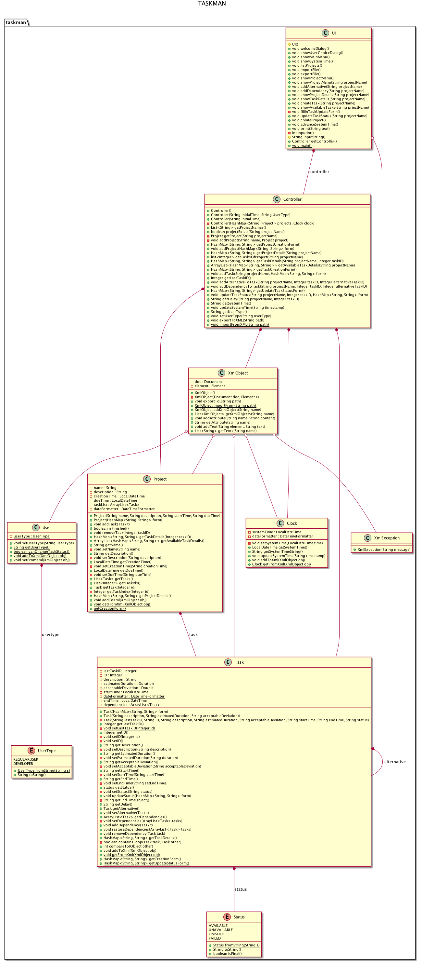
The Task class
Information Expert
Don’t Talk to Strangers
Mocking
Unique ID’s
Checks for loops in depencencies & alternatives
Checks overlap with timespans of dependencies
Maps for forms & details
LocalDateTime, Duration

Slide 4
The Project class
Information Expert
Task Creator in wrong class (!)
Don’t Talk to Strangers
Unique name
Tasks not shared
Maps for forms & details
LocalDateTime, Duration

Slide 5
The Clock class
Information Expert
Don’t Talk to Strangers
LocalDateTime, DateTimeFormatter

Slide 6
The User class
Information Expert
Don’t Talk to Strangers
Static class
UserType
No login
Permission checked in Controller

Slide 7
The Controller class
Controller
Creator
Indirection
Maps for forms & details
Initialize Clock, User, Projects
Checks permission
Create and signal XmlObject

Slide 8
The XmlObject class
Pure fabrication
Information expert
Import/export logic
Classes add/get text info
Checks existence of values
Throws XmlException

Slide 9
The UI class
Information Expert
Creator
Don’t Talk to Strangers
Command line interface
Maps for forms & details
Main function
Parse input strings
Mocking for print & input

Slide 10
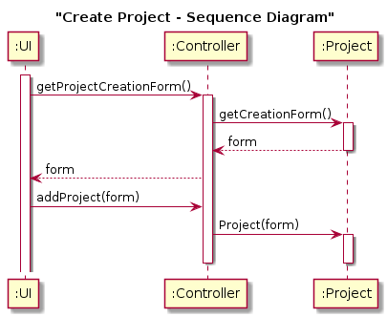
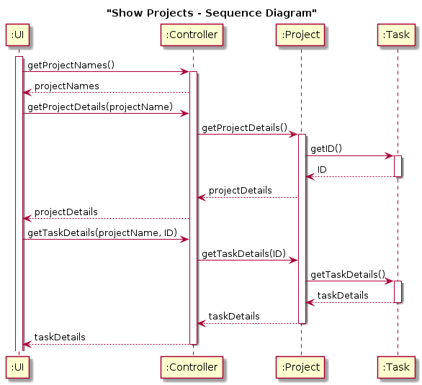
Use cases

Slide 11
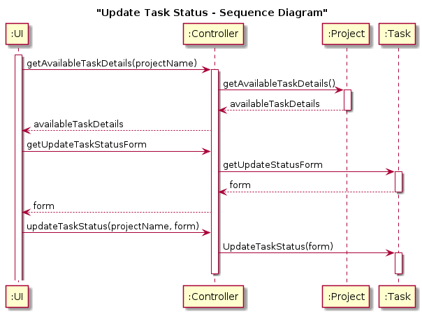
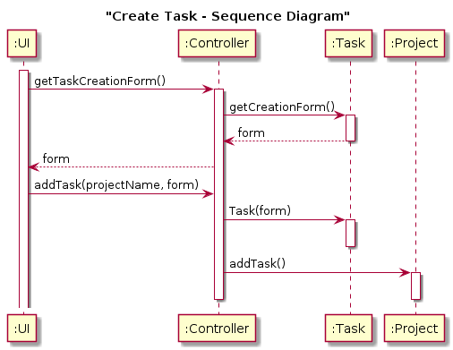
Use cases

Slide 12
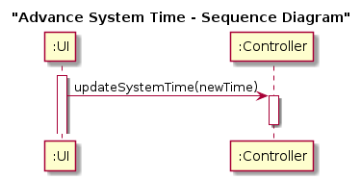
Use cases

Slide 13
Project management
Design Coordinator: Julien Benaouda
Testing Coordinator: Alexander Braekevelt
Domain Coordinator: Jeroen Van Der Donckt
... but actually everyone did everything (of his part of the code)
next iteration we will continue this approach
 | Julien | Jeroen | Alexander
group work | ±20h | ±20h | ±20h
individual work | ±60h | ±25h | ±25h
study | ±60h | ±22h | ±10h

